Slide 1
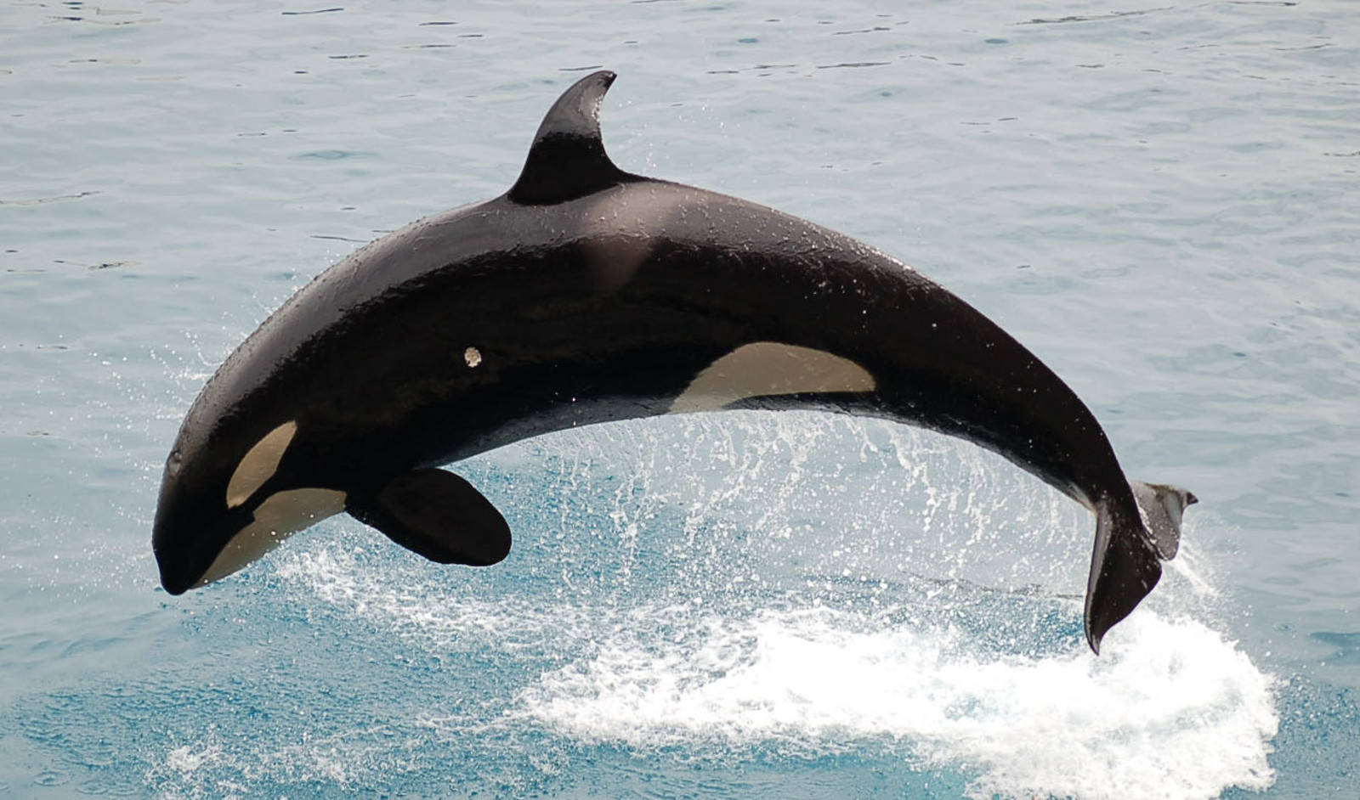
Welcome
Orca Class 2015-2016

Slide 2
Year 4/5
Maths -Number lines to formal calculations, decimals
-Problem solving, logic and reasoning
-Number bonds, times tables,
-What you can do at home
Literacy -Reading, Writing, Handwriting, SPAG
-SPAG-daily
-Reading: Guided Reading once a week, reading at home, book changing,
reading diaries
-What you can do at home
Topic -Anglo Saxons and Scots
-Weald & Downland museum
-What you can do at home – Winchester City museum, Butser Ancient Farm

Slide 3
Timetable
Mondays-Music (ukelele, brass, clarinet) with Mrs Harmer
Tuesdays-French with Mr Morawek
Wednesdays-Mrs Angio, multiskills, RE, maths investigations, big write
Fridays- Library, swimming
Learning Logs-each week, overview each half term
WOW Work-out on Thursday, in on Wednesday, projects
Spellings – 2 weeks worth, out on Thursdays, test on Tuesdays
Letters-Wednesdays

Slide 4
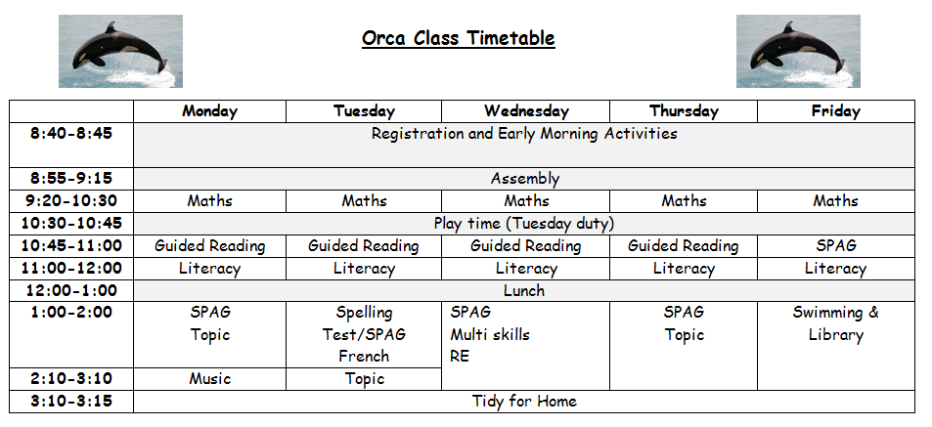

Slide 5
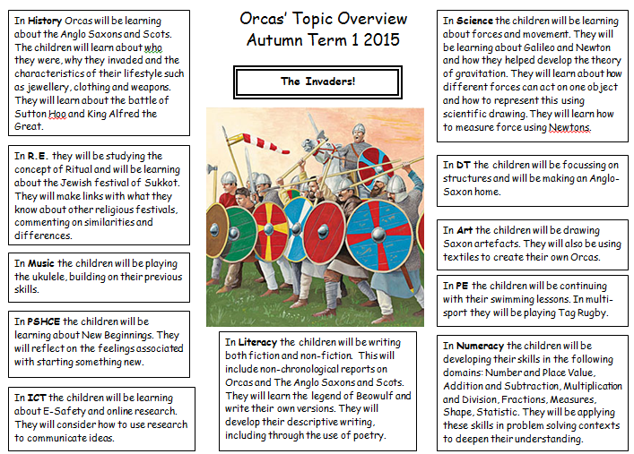

Slide 6
Targets
Targets for Writing and Maths – linked to NC
Works on level above current level
Displayed in books and in classroom
Checked regularly throughout the half term and changed accordingly
Children knowing them

Slide 7
Other
Residentials & Challenge Days
Clubs – invitation, music lessons, other
Behaviour expectations

