Slide 1

Phonics and Reading
Parents Workshop
Monday 29th September 2025

Slide 2

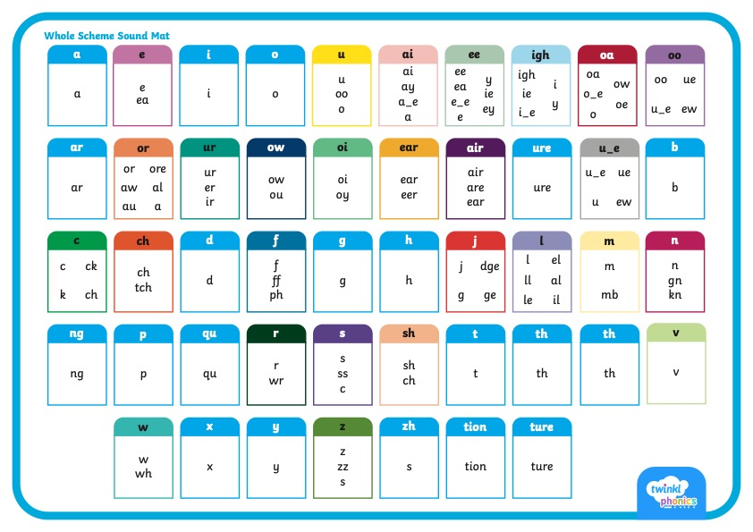
      Did You Know…?
There are 26 letters in the alphabet but there are 44 sounds and over 100 different ways of spelling them.
This is why English is one of the most complex languages to learn!

Slide 3


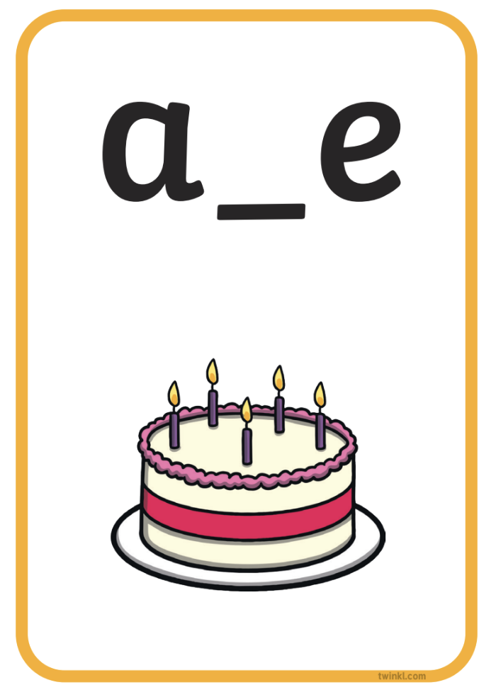


Phonics Terminology
Here is some of the terminology you might hear as your children begin to learn phonics.
Phoneme | the smallest unit of sound in words
Grapheme | the written representation of a sound
GPC (Grapheme-Phoneme Correspondence) | being able to match a phoneme with the correct grapheme and vice versa
Blending | joining individual speech sounds together to read a word
Segmenting | breaking down words into individual speech sounds to spell a word
Digraph | two letters making one sound e.g. ‘sh’
Trigraph | three letters making one sound e.g. ‘igh’
Split Digraph | two letters making one sound which are divided by a consonant e.g. the i_e sound in the word ‘side’
Tricky/Common Exception Words | words that are not fully decodable such as ‘the’ and ‘was’
Sound buttons | Dots, dashes and dives can be written underneath a sound to support reading
Sound bars | lines that can be written underneath digraphs or trigraphs to show that the letters make one sound
Mnemonic | a visual prompt to help children remember a sound

Slide 4



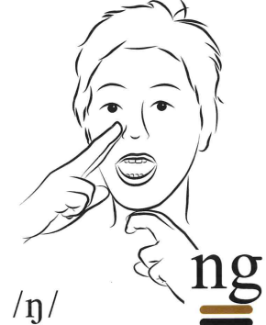
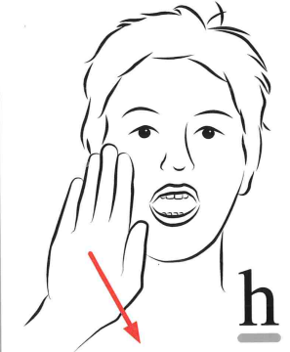
Cued Articulation
Across KS1 we have started using cued articulation when introducing a new sound.

Slide 5
Sound buttons
Dots
Single sounds
e.g. s, p, l
Dashes
Digraphs, trigraphs
e.g. ai, oa, ss
Dives
Split digraphs
e.g. o-e,
a-e, e-e
pen
ground
skirt
snake
flute

Slide 6



      How You Can Help Your Child at Home – Phonics
Work on listening skills, taking turns and encouraging your child to look at you when you are speaking.
Practise segmenting and blending words.
Look for familiar sounds and words in the world around you. Such as, when in the supermarket, can your child find words on your shopping list or recognise letters on food packaging?
When outside, can they recognise letters on street names or on car number plates?
When in the house, can they recognise letters or words in magazines or letters you receive?

Slide 7
      How You Can Help Your Child at Home – Reading
Make Reading Fun
Reading should never seem like a punishment or a chore. Try playing games related to the book or try reading something that you both enjoy. Remember, you do not just have to read ‘books’: you could enjoy an online article, a reference book or even a comic together.
Provide a Choice of Reading Materials
Reading isn’t just about school books. Try joining the library together, following instructions from a recipe book or even letting your child be in charge of the shopping list when you are at a supermarket.

Slide 8
      How You Can Help Your Child at Home – Reading
Show That You Read Too
Hearing an adult read from a text that is a higher level than they would be able to access on their own is really important for developing new vocabulary. Why not share an interesting article you’ve found online with your child so that you can learn together?
Ask Lots of Questions
Whatever your child is reading, make sure that you ask them lots of questions about it. Are they enjoying the text? Do they have any new facts to share?

Slide 9
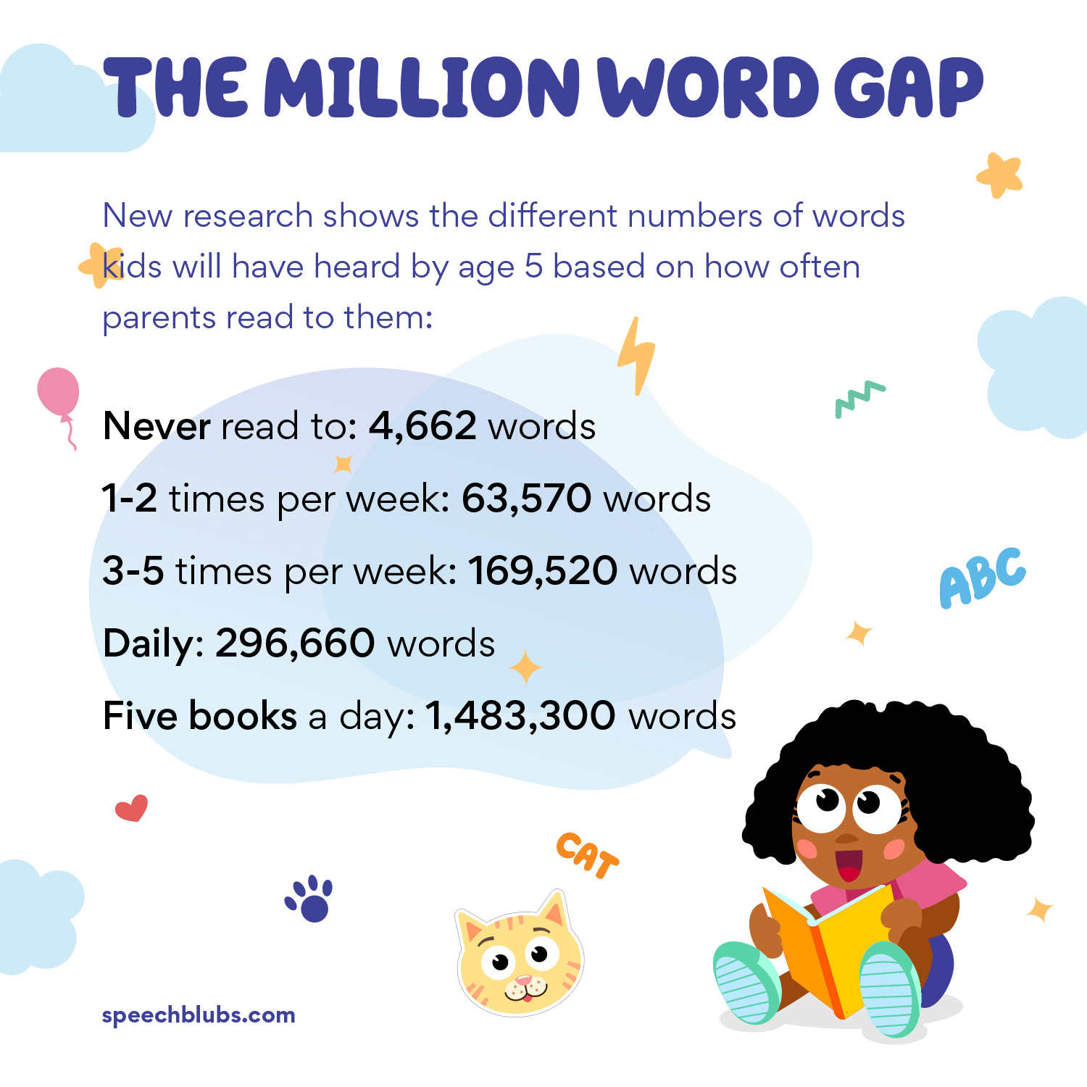
      Reading Everyday
Children should be given the opportunity to read every day. Where possible, they should be able to read with somebody else who can help them with tricky words and make sure that they understand the text.
When listening to your child read, it’s important to ask questions along the way as well as at the end. These are vital skills that will help to develop their reading comprehension.

Slide 10
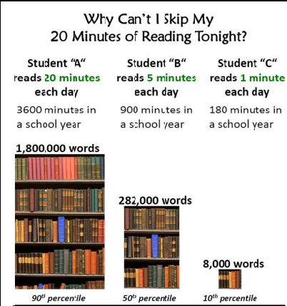
Once a child is a fluent reader and reads independently, spend some time with them talking about what they have read after. This is a great way to stay engaged in their reading but also helps you to see if they are understanding their book.

Slide 11
      Supporting Reading
We would like all children to enjoy reading rather than see it as an effort or hard work, but we know that isn’t always easy.
• Share reading activities and interact with the text together
• Offer alternative reading material, e.g. magazines, non – fiction books, comics, blogs, etc...
• Encourage reading at different times of the day or week
• Share the problem with your child’s teacher, we are here to help!

